Slide 1

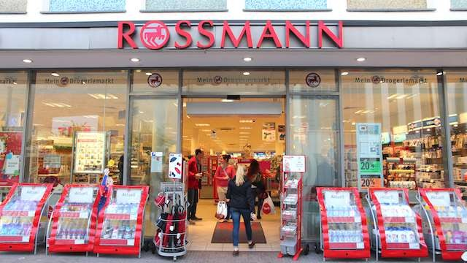

Capstone Project - 2
Retail Sales Prediction By
Contributor Role
Suraj Kad (suraj.kad.90@gmail.com)
Shubham Sawant (shubhamsawant248@gmail.com)
Tanvir Patel (tanviripatel1998@gmail.com

Slide 2
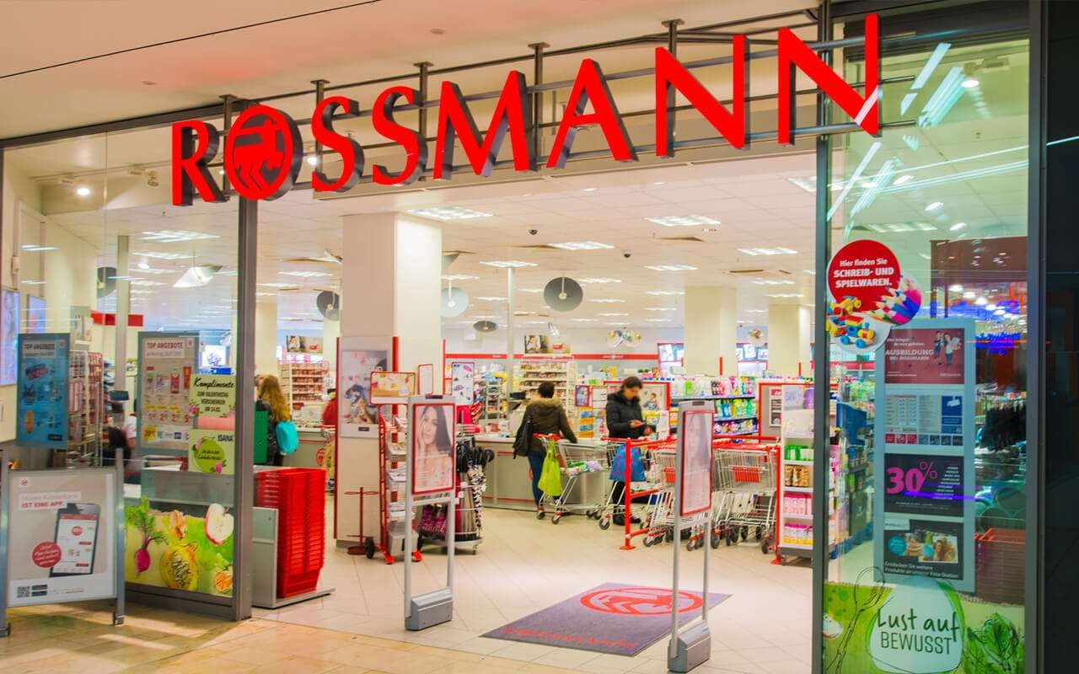
Content:
Problem Statement
Data Summary
Data Preprocessing
Exploratory Data Analysis
Feature Engineering
Model Implementation
Linear Regression Lasso Regression
Decision Tree Regression
Conclusion and Recommendations

Slide 3
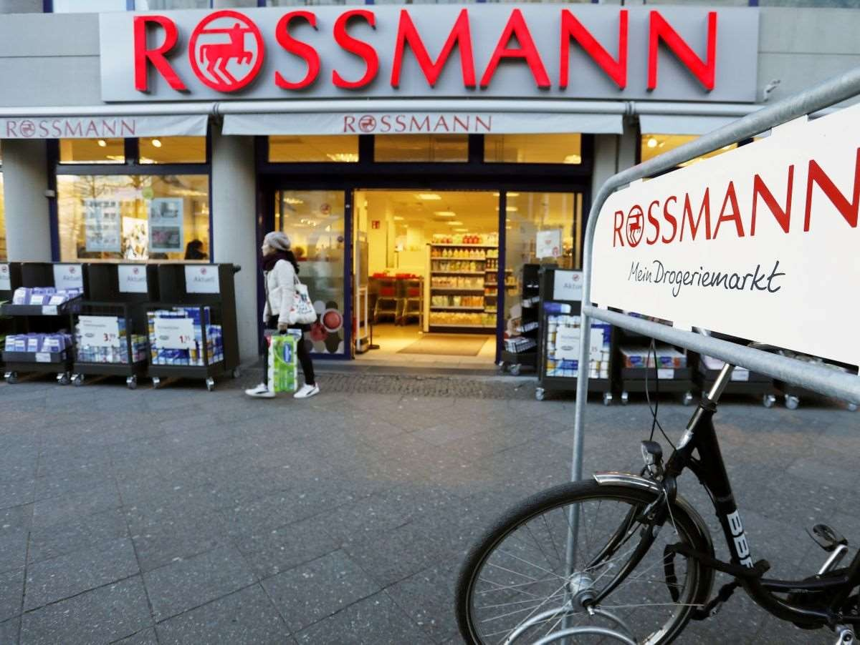
Problem Statement
Rossmann operates over 3,000 drug stores in 7 European countries. Currently, Rossmann store managers are tasked with predicting their daily sales for up to six weeks in advance.
Store sales are influenced by many factors, including promotions, competition, school and state holidays, seasonality, and locality. With thousands of individual managers predicting sales based on their unique circumstances, the accuracy of results can be quite varied.
You are provided with historical sales data for 1,115 Rossmann stores. The task is to forecast the "Sales" column for the test set. Note that some stores in the dataset were temporarily closed for refurbishment.

Slide 4
Data Summary:
We have two datasets. Rossman store data is for years 2013, 2014 and 2015 with 10,17,209 observations on 9 variables. Stores data with 1115 observations on 10 variables. Some important features are: -
Id - an Id that represents a (Store, Date) duple within the set
Store - a unique Id for each store
Sales - the turnover for any given day (Dependent Variable)
Customers - the number of customers on a given day
Open - an indicator for whether the store was open: 0 = closed, 1 = open
State Holiday - indicates a state holiday. Normally all stores, with few exceptions, are closed on state holidays. Note that all schools are closed on public holidays and weekends. a = public holiday, b = Easter holiday, c = Christmas, 0 = None
School Holiday - indicates if the (Store, Date) was affected by the closure of public schools
Store Type - differentiates between 4 different store models: a, b, c, d
Assortment - describes an assortment level: a = basic, b = extra, c = extended. An assortment strategy in retailing involves the number and type of products that stores display for purchase by consumers.
CompetitionDistance - distance in meters to the nearest competitor store
CompetitionOpenSince[Month/Year] - gives the approximate year and month of the time the nearest competitor was opened
Promo - indicates whether a store is running a promo on that day
Promo2 - Promo2 is a continuing and consecutive promotion for some stores: 0 = store is not participating, 1 = store is participating
Promo2Since[Year/Week] - describes the year and calendar week when the store started participating in Promo2
PromoInterval - describes the consecutive intervals Promo2 is started, naming the months the promotion is started anew. E.g. "Feb,May,Aug,Nov" means each round starts in February, May, August, November of any given year for that store.

Slide 5
Approach
The following approach was followed in the completion of the project:
Business Problem
Data Collection and Preprocessing
- Data Cleaning
Missing Data Handling
Merging the Datasets
Exploratory Data Analysis
Data Manipulation
Feature Engineering
Outlier Detection and Treatment
Feature Scaling
Categorical Data Encoding
Modeling
Train Test Split
Linear Regression
Lasso Regression
Decision Tree Regression
Random Forest
Model Performance and Evaluation
Conclusion and Recommendations

Slide 6
Exploratory Data Analysis
Hypotheses
Just by observing the head of the dataset and understanding the features involved in it, the following hypotheses could be framed:
There's a feature called "DayOfWeek" with the values 1-7 denoting each day of the week. There would be a week off probably Sunday when the stores would be closed and we would get low overall sales.
Customers would have a positive correlation with Sales.
The Store type and Assortment strategy involved would be having a certain effect on sales as well. Some premium high quality products would fetch more revenue.
Promotion should be having a positive correlation with Sales.
Some stores are closed due to refurbishment, those would generate 0 revenue for that time period.
There would be some seasonality involved in the sales pattern, probably before holidays sales
would be high.

Slide 7
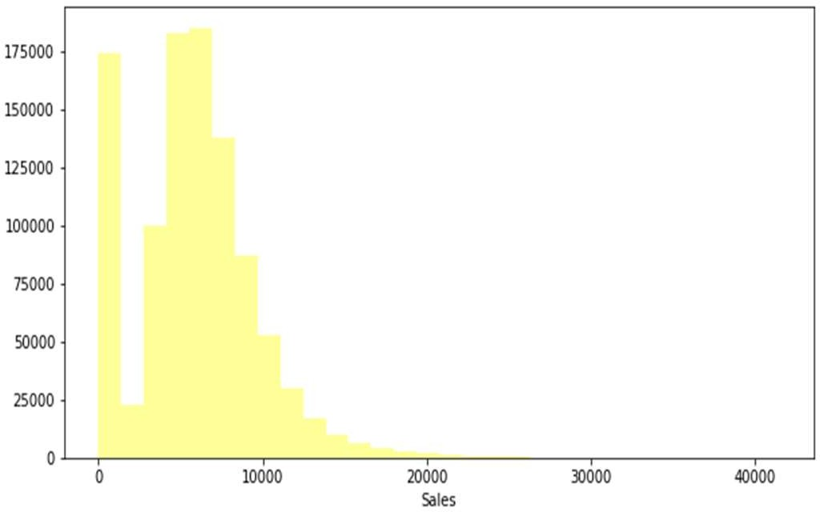
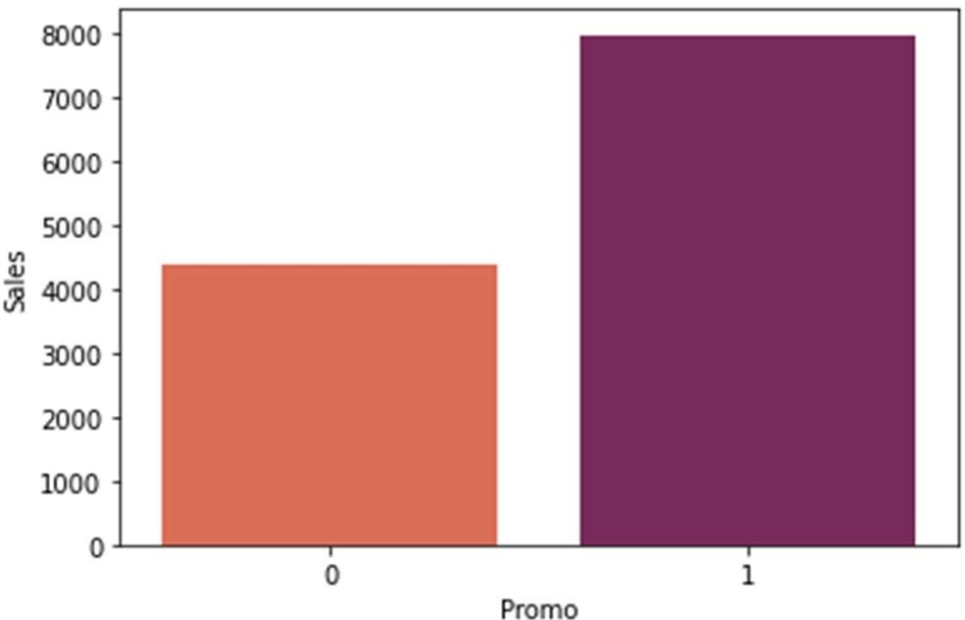
Impact of Promo on sales
Sales are normally distributed with slightly right tail skewed.
Histogram Representation of Sales. Here 0 is showing because most of the time store was closed
Sales Are nearly doubled High When Promotion is Running.

Slide 8
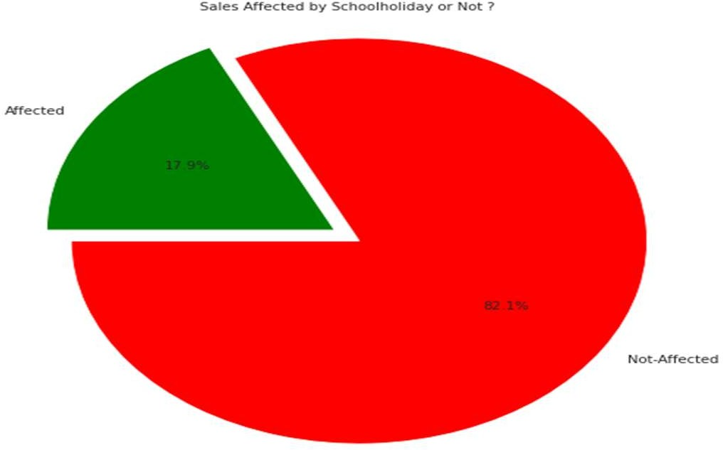
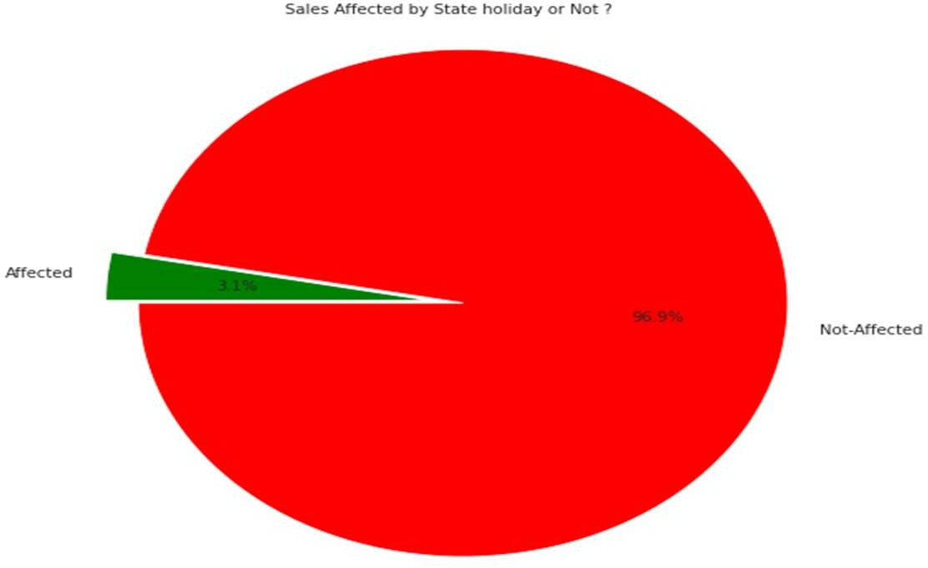
we can understand the school holiday are affected on sales or not
Understand can state holiday affected on the sales?
"As we can see in the Pie chart... Sales affected by School Holiday is 18% and Mainly Sales aren’t affected by School Holiday"
As we can see in the Pie
chart Sales affected by State Holiday is only 3% means Sales aren't affected by State Holiday. As Sales isn't much affected by State Holiday so I’m removing this column

Slide 9
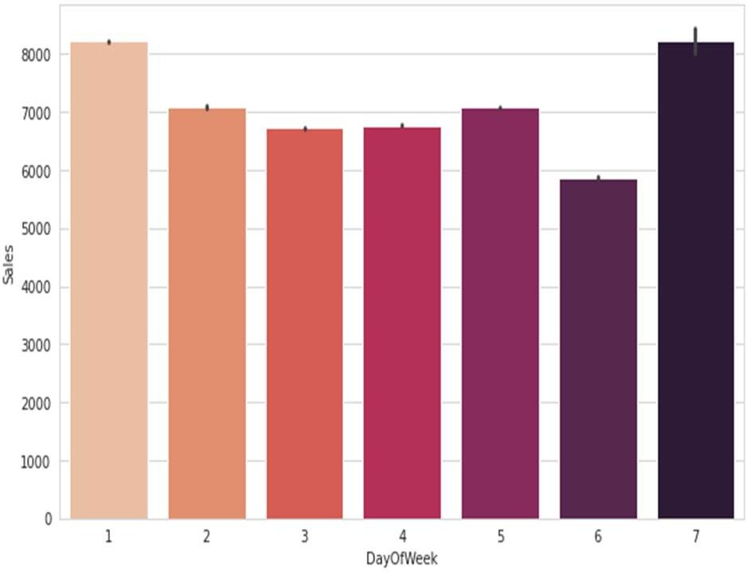
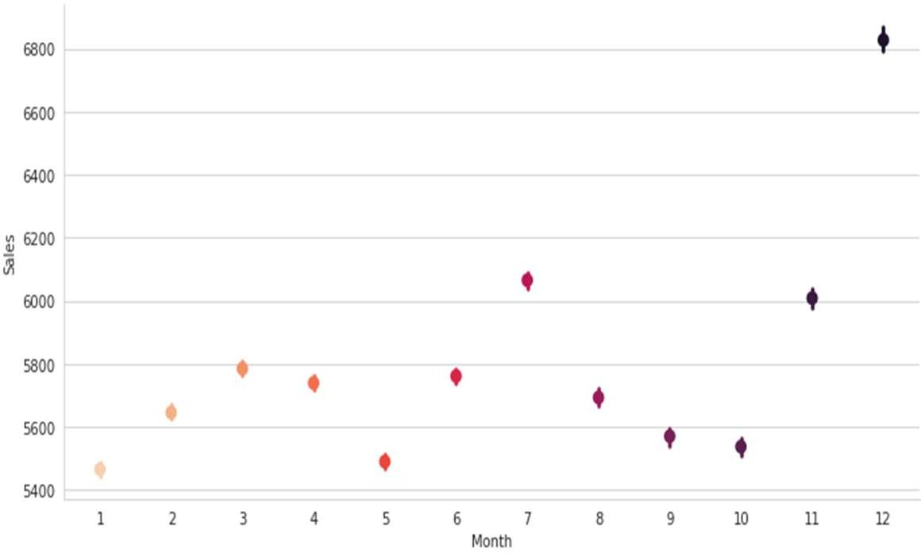
Day Wise trends in Sales
Monthly trends in Sales
From plot it can be Sen that most of the sales have been on 1st and last day of week.
As We can see that in the month of November and Specially in December Sales is increasing Rapidly every year on the Christmas

Slide 10
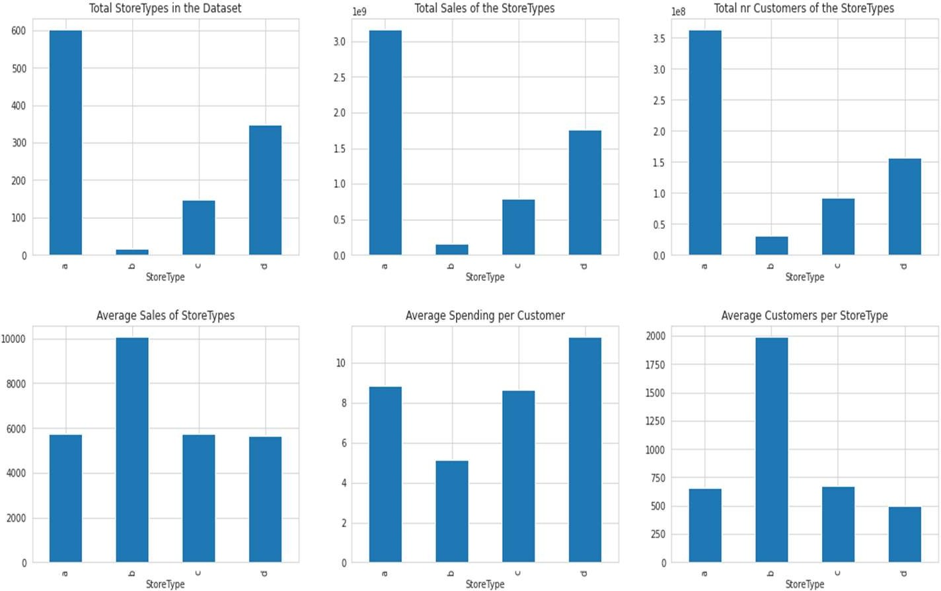
Store Types and average sales/customer/spending relation
As we can see from the graphs, the Store Type A has the most stores, sales and customers.
However, the Store Type D has
the best averages pending per customers. Store Type B, with only 17 stores has the most average c

Slide 11
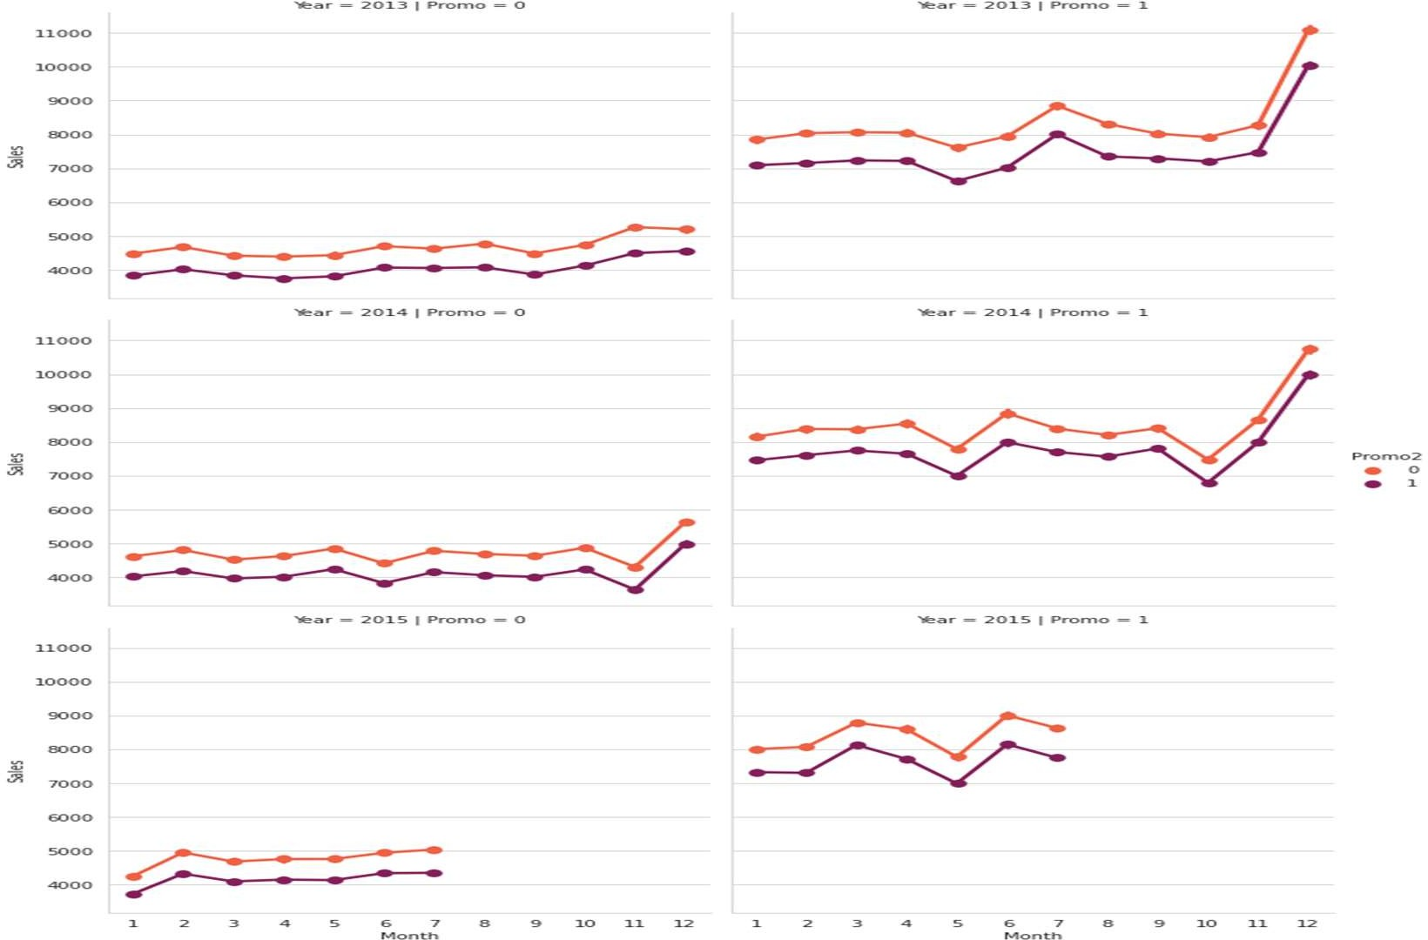
Understand can promotion affected on Sales
So, of course, if the stores are having promotion the sells are higher.
Overall the store promotions selling's are also higher than the seasonality promotions (Promo2). However I can't see no yearly trend.

Slide 12
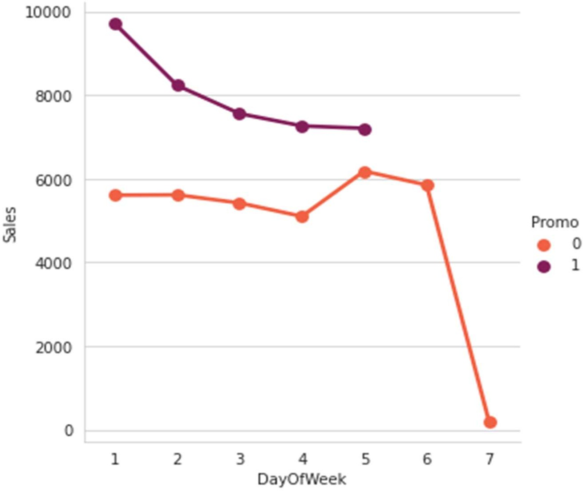
As We can see that when the promotion is running Sales are high.
So, no promotion in the weekend.
However, the sales are very high, if the
stores have promotion. The Sales are going crazy on Sunday. No wonder.

Slide 13
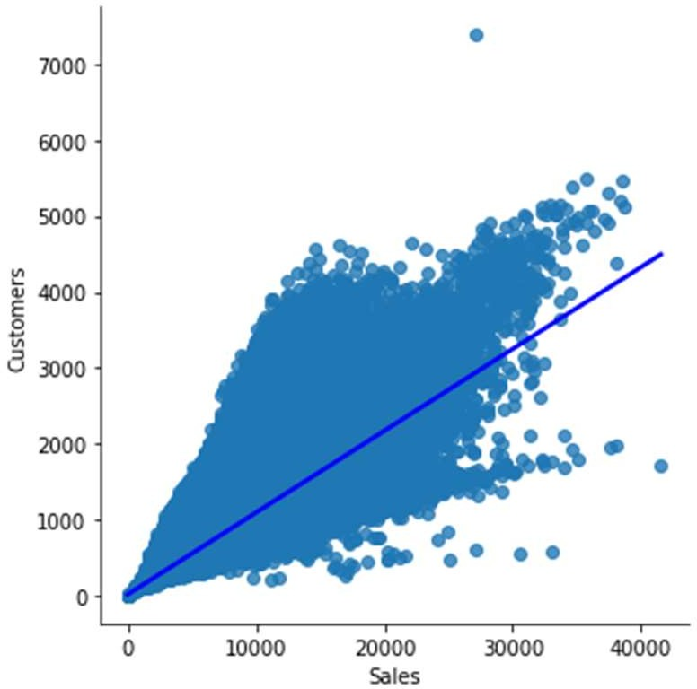
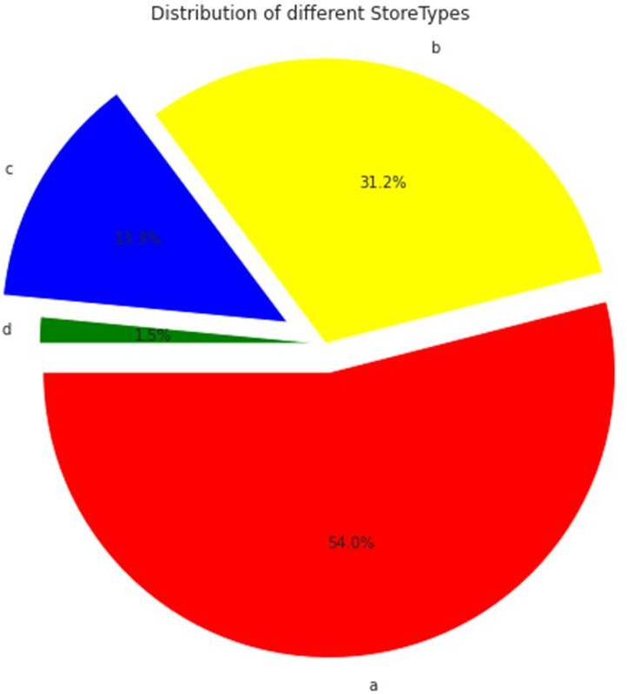
Sales VS Customer
Distributions of different store type
This pie chart show in distribution of store name are a,b,c and d respectively. So a store distribution is 54% ,second b store distribution is app. 32% ,
c store is 23% and last store d is a 1.5%
As we can see from the graphs, the Sales are correlated in a customers.

Slide 14
EDA Conclusion:
Sales are highly correlated to customers.
Stores opened on ‘State Holiday’ makes a good amount of sales.
There is no such significant difference in sales on ‘School Holidays’.
Even though store type ‘b’ has very a smaller number of stores but these are outperforming other store types in terms of sales and avg customers.
Sales are consistent for the second quarter of the year but it starts increasing in the last quarter.

Slide 15
Modeling:
Factors affecting in choosing the model:
Determining which algorithm to use depends on many factors like the problem statement and the kind of output you want, type and size of the data, the available computational time, number of features, and observations in the data, to name a few.
The dataset used in this analysis has:
A multivariate time series relation with sales and hence a linear relationship cannot be assumed in this analysis. This kind of dataset has patterns such as peak days, festive seasons etc. which would most likely be considered as outliers in simple linear regression.
Having X columns with 30% continuous and 70% categorical features. Business prefers the model to be interpretable in nature and decision based algorithms work better with categorical data.

Slide 16
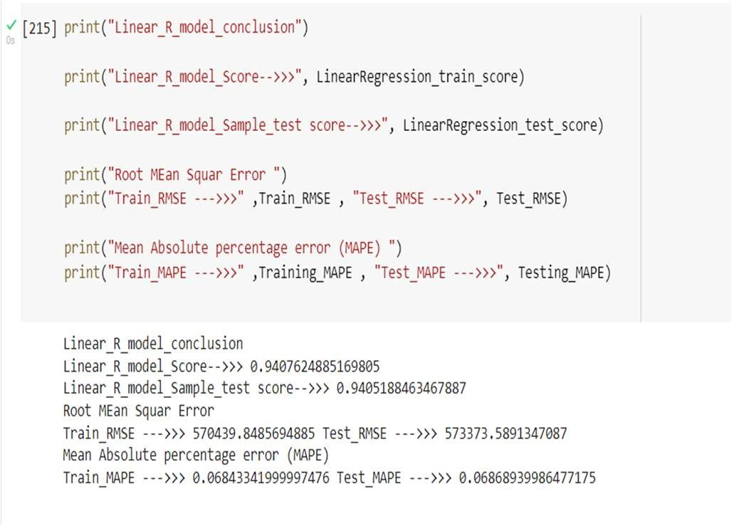
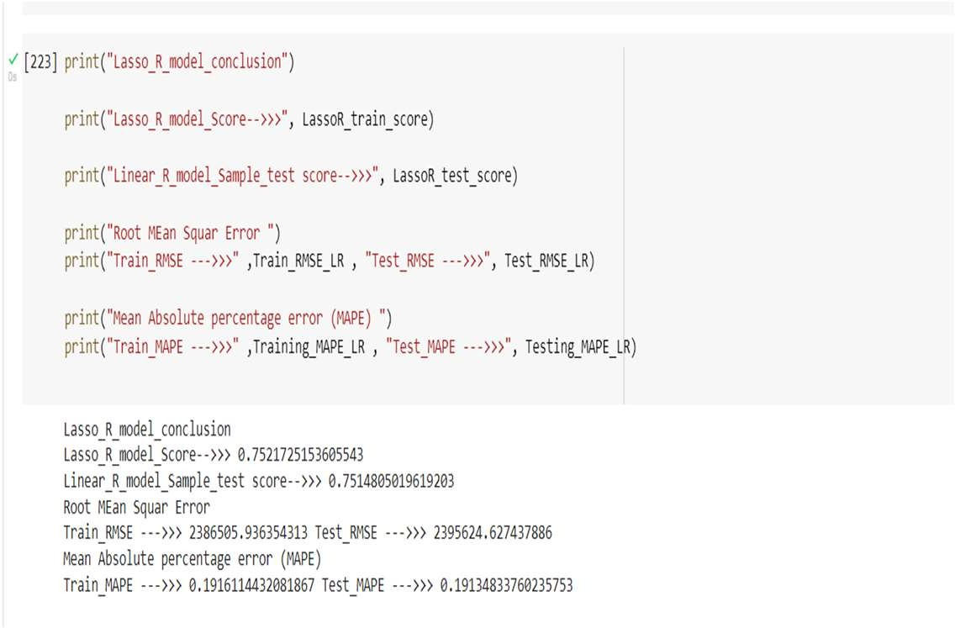
Linear Regression
Lasso Regression

Slide 17
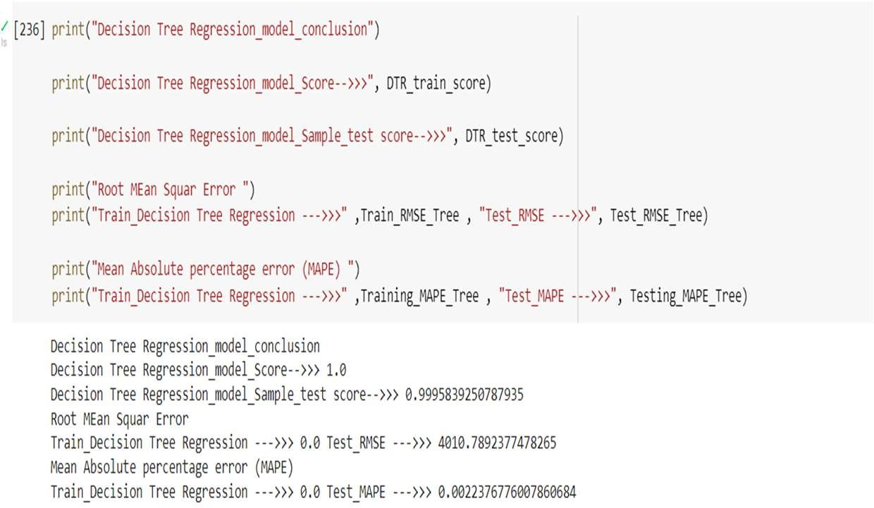
Decision Tree
A baseline is a simple model that provides reasonable results on a task and does not require much expertise and time to build. It is well established that there is seasonality involved and no linear relationship is possible to fit. For these kinds of datasets tree based machine learning algorithms are used which are robust to outlier effect which can handle non-linear data sets effectively.
The results show that a simple decision tree is performing pretty well on the validation set but it has completely overfitted the train set. It's better to have a much more generalized model for future data points.

Slide 18
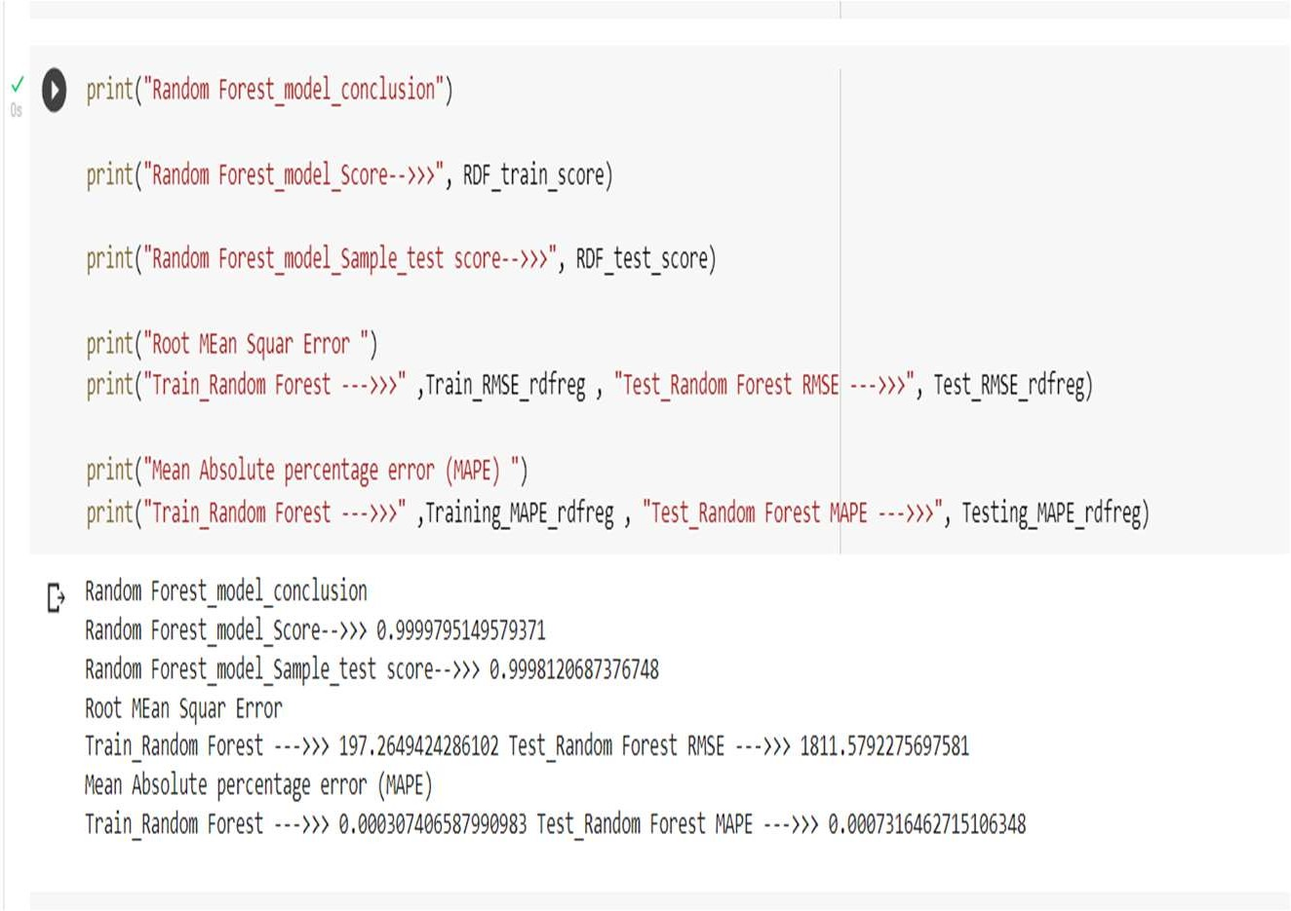
Random Forest
Random forests are an ensemble learning method for classification and regression that operates by constructing a multitude of decision trees at training time. For regression tasks, the output of the random forest is the average of the results given by most trees.
To prevent overfitting, we built random forest model. Random forest builds multiple decision trees and merges them together to get a more accurate and stable prediction.

Slide 19
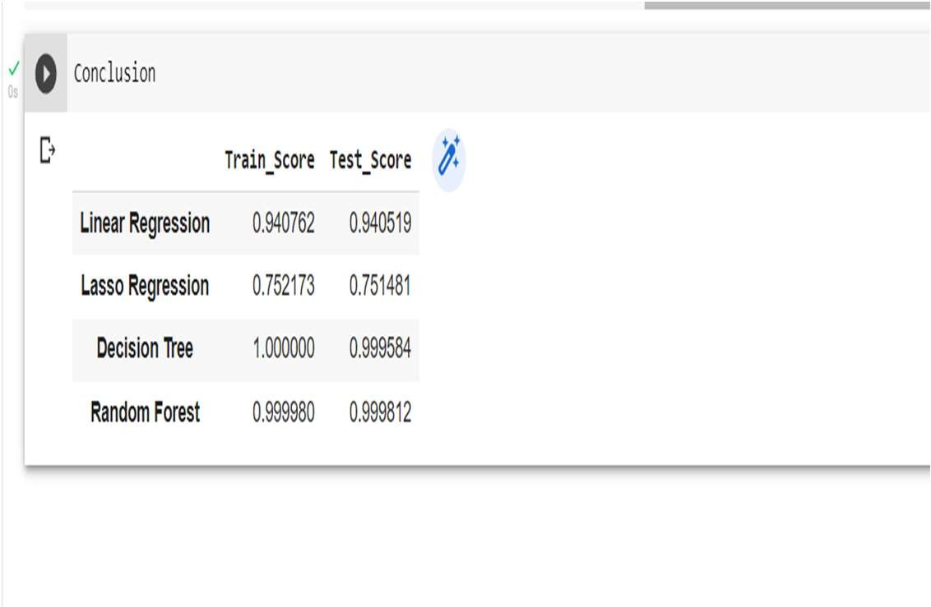
Model Evaluation
Predictions from random forest model are very close to actual values
in our X dataset as we have good score. The figure shows actual values, predicted & the difference between them respectively.
Since this is Sales prediction MAE is a good metric.
We’re getting Mean Absolute Error ~ $ 197.23
And MAPE of 0.007%

Slide 20
Conclusion:
Our model shows that Customers, Competition distance, Store type are some of the most important features in our sales prediction.
We need to focus on these aspects to maximize our profits for the next 6 weeks.

Slide 21




